Slide 1
MSc Project
CMP060L050
Workshop: Literature Review
Dr Mohammad Javaheri
Associate Professor in AI

Slide 2
Agenda
Understanding Literature Reviews
Preparing for a Literature Review
Reading and Analysing Literature
Organising and Structuring a Literature Review
Writing and Drafting
Critical Appraisal and Analysis

Slide 3
What is a Literature Review?
A literature review is a comprehensive summary and critical evaluation of existing research on a specific topic.
It serves as the foundation for your project by synthesising previous findings and identifying gaps.
Example:
For an MSc AI project focused on deep learning, the literature review could cover recent advancements in neural networks, comparing various architectures such as CNNs, RNNs, and GANs.
A literature review on web frameworks might compare React.js and Vue.js in terms of performance, ease of use, and developer community support.

Slide 4
Objectives a Literature Review
Four main objectives:
Surveys the literature
Summarise key findings from a wide range of sources.
Synthesis of Information
Combine findings from various studies into a cohesive summary.
Critical Analysis
Identify gaps, contradictions, and limitations in the existing research.
Presentation of Information
Structure the review in a logical way.

Slide 5
What is a literature review?
Not Just a Bibliography
A literature review involves critical engagement with sources and synthesising information.
It goes beyond merely listing articles to analysing their methodologies, strengths, and weaknesses.
Develops an argument by summarising and presenting key information and synthesis (reorganisation of information)
Distinguishes what has already been done and identifies what needs to be done (Hart, 1998)
How your work connects with current literature needs to be explicit.
Framework where new findings are compared to previous findings presented in the literature (comparative analysis)

Slide 6
What is a literature review?
Critical Engagement Example:
“The study by Lewis et al. (2019) focuses on Angular’s effectiveness in large-scale applications but fails to consider the challenge of integrating Angular with existing backend technologies like Node.js, which can limit its applicability.”
“Although Jones et al. (2020) argue that unsupervised learning methods outperform supervised models in terms of generalisation, their methodology lacks robustness in evaluating edge cases, which may lead to biased conclusions.”

Slide 7
Literature Review: A Process
The literature review: a synthesis of studies on any given topic.
The process involves multiple stages: identifying sources, analysing and synthesising them, and drafting the review.
Example:
If writing a literature review on web accessibility, you would gather research on WCAG (Web Content Accessibility Guidelines), studies on improving website accessibility, and critiques of current best practices.
A literature review on reinforcement learning might require examining both classical models and the latest research on deep Q-networks (DQNs), followed by a synthesis that critiques and highlights gaps in the existing models.
The process can take months!

Slide 8
How is a literature review different to an essay?
Essays:
Present arguments with a focus on personal opinion or critical thinking on a topic.A critical appraisal of this research (similarities, differences, strengths, weaknesses, inconsistencies)
Literature Review:
Focuses on analysing, synthesising, and critiquing existing research. It is not about arguing for or against a specific perspective but understanding the state of knowledge.

Slide 9
How is a literature review different to an essay?
Critical annotation example:
“While several studies have shown the effectiveness of decision trees (Brown et al., 2019), others (Taylor & Lee, 2021) highlight their inability to handle non-linear data efficiently. The ongoing debate indicates that while decision trees remain popular, hybrid models like random forests may be more effective in many real-world scenarios.”

Slide 10
Literature Review: Preparations
Define the Type of Review:
Quantitative (theory-driven) vs qualitative (theory-building). Choose appropriate sources.
Either choice will determine your emphasis on statistics.
Example:
For a quantitative review, you might focus on studies that employ statistical methods to measure AI model performance.
For qualitative reviews, focus on theoretical papers that explore AI's implications on society.

Slide 11
Evaluating & Interpreting Research
Accuracy and Bias:
Stick to peer-reviewed sources and verify the credibility of the research.
Some Internet sources can be very up-to-date and, therefore can be especially useful if statistics are required.
statista, ons, government Web sites, etc.
Finally, take caution when you encounter research studies.
especially qualitative research studies that attempt to show causality.
Example:
“The study by Turner et al. (2020) presents performance data of web frameworks, but it uses outdated tools like PhantomJS, which no longer represents the current state of web performance testing.”

Slide 12
Approaching The Literature Review
Completing a literature review requires planning, time, reading, writing, drafting, reflection, and editing.
A successful literature review has a firm idea of the research problem and an understanding of the research framework/paradigm.
To refine the research problem, you need to conduct preliminary research to help narrow your focus and identify key search terms.

Slide 13
Approaching The Literature Review
You are expected to place your research in the existing academic literature/industrial practices.
Simply describing the literature should be avoided.
A critical and analytical judgement which demonstrates how/where/why your work is best placed as well as work that needs developing is essential.
Your work should contribute to existing literature in the field.
Ensure consideration is given to the methodological and/or theoretical arguments that inform the literature.
Be aware of how research paradigms influence the research.

Slide 14
Reading and Analysing Literature (PQRS Framework)
P (Problem):
What is the study’s main issue?
How does Angular compare to React in terms of speed and flexibility?
Q (Questions):
What research questions does the study answer?
Does Angular provide better modularity than React?
R (Results):
What findings were reported?
React is faster than Angular, but Angular’s two-way data binding is superior.
S (Significance):
What does this contribute to the field?
This highlights the trade-offs developers must make when selecting frameworks.

Slide 15
Reading and Analysing Literature (PQRS Framework)
Example of applying PQRS:
“The study by Wilson et al. (2018) explores the problem of data scarcity in training neural networks (P). They ask how unsupervised learning can mitigate this issue (Q). Their results suggest that unsupervised models reduce overfitting in low-data scenarios (R). This is significant because it can improve the applicability of AI in real-world scenarios with limited datasets (S).”

Slide 16
Reading and Analysing Literature (PQRS Framework)
Example of applying PQRS:
“In the study by Smith et al. (2021), the researchers compared React and Angular (P). Their primary question was to assess framework performance and flexibility (Q). They found React is faster but lacks some of the flexibility offered by Angular’s data-binding capabilities (R). This highlights the critical decision developers face when selecting a framework based on project requirements (S).”

Slide 17
Thesis Statement
A thesis statement is a statement of one's core argument, the main idea(s), and/or a concise summary of a research project
It is usually expressed in one or two sentences
Example:
Companies claim to act in a corporately socially responsible manner despite continuing to engage in business that is fundamentally unsustainable.
Information and Communication Technology allows employees to be constantly chained to their ICT.

Slide 18
Thesis Statement
Example:
“Despite the growing popularity of frameworks like React and Vue, there is a lack of research on how hybrid development approaches (e.g., combining Vue for frontend and Node.js for backend) impact the scalability of web applications.”
Critical annotation example:
“While the work by Anderson et al. (2020) focuses on front-end frameworks, it doesn’t address full-stack implementations, particularly the integration of these frameworks with backend technologies like Node.js and Express.js.”

Slide 19
Thesis Statement
Example:
“Despite the rapid advancements in deep learning, current research still struggles to address interpretability and ethical concerns in AI models.”
Critical annotation example:
“While many AI papers, such as Smith et al. (2019), have focused on improving model accuracy, fewer have discussed how to make these models interpretable to non-experts. The literature review should place these limitations within the broader context of AI ethics and transparency.”

Slide 20
Research Questions Based on Thesis Statement
Example Questions:
How do hybrid web applications that use React.js and Node.js perform in terms of speed and scalability?
What are the security implications of using Angular for single-page applications (SPAs)?
How does the use of transfer learning impact the accuracy of neural networks in computer vision tasks?
What are the ethical implications of deploying AI models in healthcare?

Slide 21
Common Approaches to Organising A Lit Review
Chronological:
Present studies in the order of publication
depending on the nature of your literature and development of ideas, a chronological approach will present the development of a key trend and/or progressions and changes in practices.
Thematic/conceptual:
Group literature based on common themes
time is not a factor here. The review of the literature will be around particular topics/issues/theories.
Methodological:
Focus on the methodologies used in the studies (e.g., case studies vs benchmarking studies).

Slide 22
Sample Structure for A Lit Review
Introduction
Thesis statement
Purpose of the review and concise overview of the research problem
Outlines the organisational pattern of the review/sequence of themes covered and the scope of the research
Limits, inclusion/exclusion criteria should be clearly outlined.
Body
Summarisation and Synthesis (discusses and presents findings from the literature)
Ensure continuity by summarising each theme/section and presenting how it relates to the following section.
Conclusion
Concise summary of the findings
Presents a rationale for conducting future research
Identified gaps in the literature should lead logically to the purpose of the proposed study

Slide 23
Sample Structure for A Lit Review
Introduction:
Define the scope of the review, introduce the research question, and state the purpose.
Example:
“This review focuses on comparing popular JavaScript frameworks like React, Vue, and Angular, specifically in terms of their scalability and performance in large-scale web applications.”
“This literature review examines AI applications in healthcare, focusing on machine learning models used in medical imaging and diagnostics. The purpose is to identify research gaps in model accuracy and interpretability.”

Slide 24
Sample Structure for A Lit Review
Body:
Summarise and synthesise studies, linking them to your research questions.
Conclusion:
Summarise the key findings and outline the need for further research.

Slide 25
Common Mistakes to Avoid
Not linking findings to your research:
Don’t just summarise; critically engage with the findings.
Relying too heavily on secondary sources:
Always prioritise primary research articles or case studies.
Lack of critical analysis:
Ensure you critique research methods and findings.
“While Smith et al. (2021) highlight that React is faster, they fail to account for real-world issues like SEO, which is a limitation for modern single-page applications (SPA).”

Slide 26
Drafting Strategies
Maintain a logical progression, using headings and subheadings to guide the reader through themes.
Demonstrate consistencies in and relationships between the literature you’ve studied.
Likewise, emphasise the stronger studies (e.g., have better measurements or more consistent methods) over weaker ones.
Make the implications of your information and any suggestions for further research as specific as possible.

Slide 27
Drafting: Pitfalls to Avoid
Unprofessional language
Avoid the appearance of cheekiness/emotional appeal/first-person style.
Don’t plagiarise!
Be extremely careful with your paraphrasing and ciations
Too many quotations:
Only quote those elements which are necessary and need the utmost precision.
Lack of Fluency and Cohesiveness:
Your literature review should not read like a list of facts.
Show connections between the literature

Slide 28
Critical Appraisal
Literature review needs to be critical, not just descriptive.
Compare and contrast different sources.
Identify the flaws in the research methods used.
Example:
“In contrast to the robust study by Patel et al. (2021), which used a large, diverse dataset, Smith’s (2019) study on the same topic suffers from a narrow sample size, which undermines its conclusions.”

Slide 29
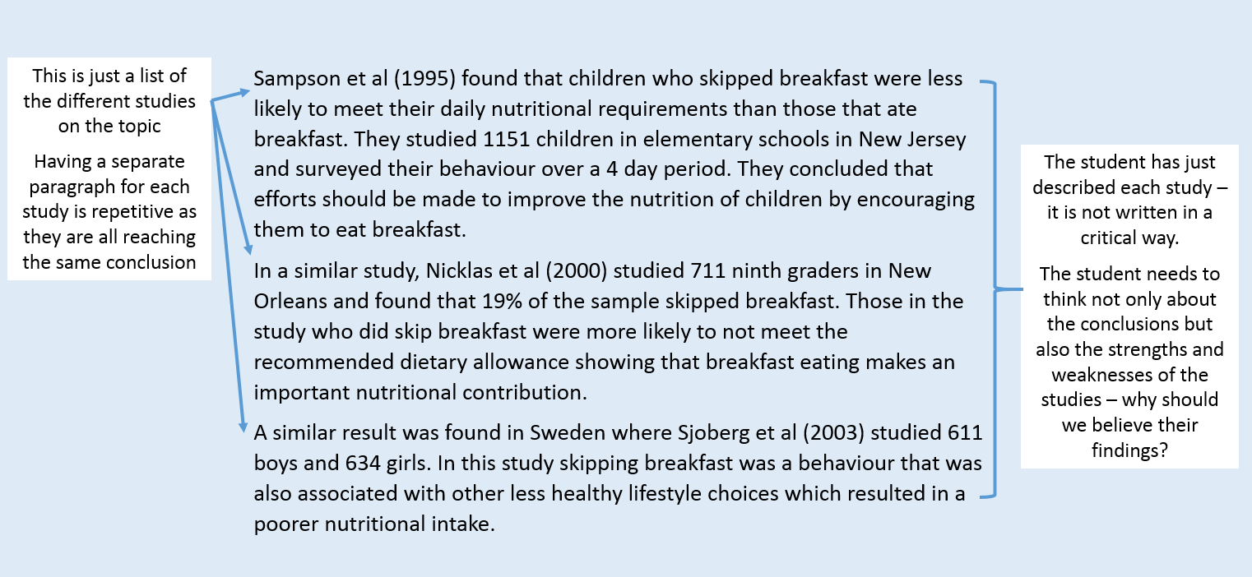
Critical Appraisal

Slide 30
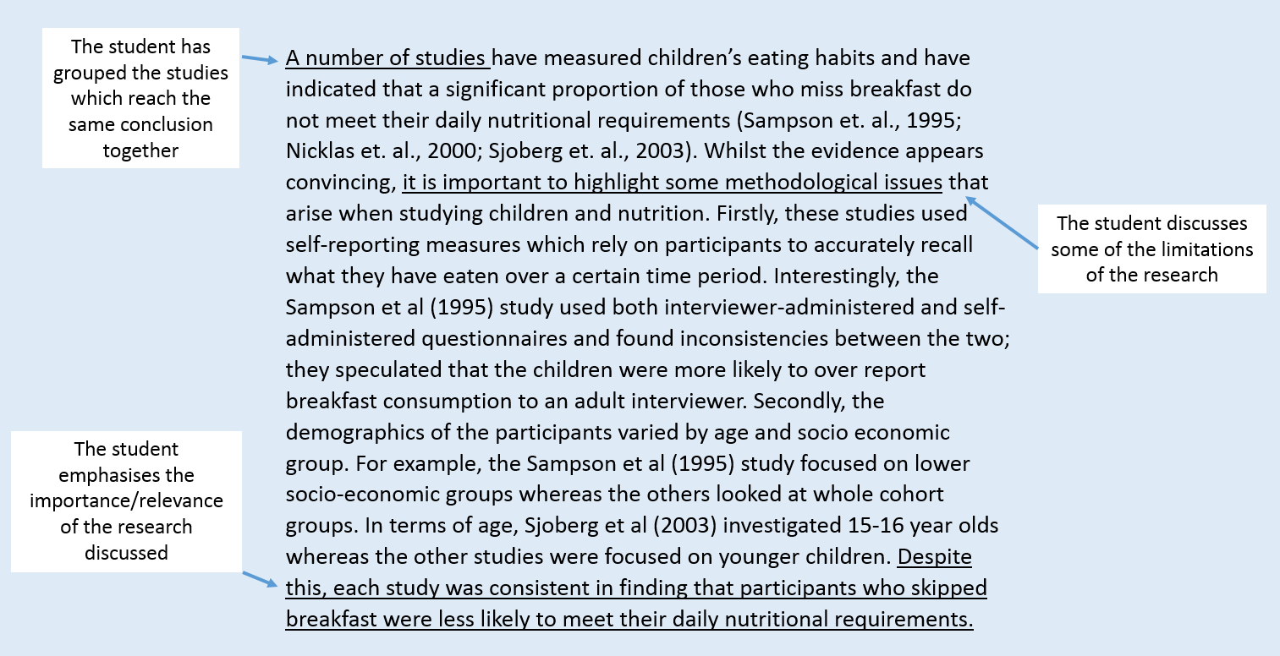
Critical Appraisal

Slide 31
Critically Analysing A Piece of Research
In the reading test the five children who were taught using phonics performed better overall than the five children taught using the whole word method. This shows that the phonics method is a better choice for schools [X].

Slide 32
Critically Analysing A Piece of Research
Browning [X] found that children taught to read using phonics did better in a reading test than children taught using the whole word method. However, the study was small and the test rather limited. An examination of Browning’s test scores reveals that, although the mean score of the phonics group was higher, two of the highest scores in the test were whole word learners. Since this indicates that the whole word method is effective for some learners at least, Browning is perhaps too quick to propose that the ‘phonics method is a better choice for schools’.
Critical assessment of methods
Evidence does not adequately support conclusion
Implications/significance in wider context

Slide 33
References and Useful Resources
Reading List on Moodle
Useful links under Milestone 4: Workshop - Literature review
[1] P. Oliver, Succeeding with your literature review: A handbook for students. Maidenhead: Open University Press, 2012.
[2] C. W. Dawson, Projects in computing and information systems. Harlow: Prentice Hall, 2009.
[3] L. A. Machi and B. T. Mcevoy, The literature review : six steps to success, 3rd ed. Thousand Oaks, California: Corwin, A Sage Publishing Company, 2016.
[4] J. Zobel, Writing for Computer Science. London Springer, 2014.

